Slide 1


SUNSTONE
“ Calendar scheduler application”
Task - 3

Slide 2
SUNSTONE
Task 3 :: Frontend Creation
Create various Front End Programs
Draw and design a uniform front end code for “Calendar Scheduler Application”
Draw and design a interactive front end code for “Calendar Scheduler Application”
Evaluation Metric:
100% Completion of the above tasks
Learning outcome
Developing complicated UI using HTML components
Using props drilling and context to pass variables
Getting familiar with different type of api calls
Handling different input data

Slide 3
SUNSTONE
Step-Wise Description
1.Define Scope and Tech Stack
Identify key features: date/time, reminders, recurring events.
Choose a scalable tech stack for efficient development.
2. UI/UX and Frontend:
Design an intuitive, responsive interface.
Develop frontend for seamless user interaction.
3. Functionality and Integration:
Enable easy date/time selection and recurring events.
Integrate with address book for efficient location input.
4.Task Organization:
Implement task prioritization, inspired by a shopping cart concept.
Allow users to categorize and label events for better organization.
5.Testing, Deployment, and Support:
Conduct thorough testing for functionality and security.
Deploy on a reliable platform and provide user support.
Summary of your task
The project aims to develop a calendar scheduler application, minimizing manual scheduling efforts. It will efficiently manage appointments, tasks, and events while providing details on user schedules, ensuring seamless organization.

Slide 4
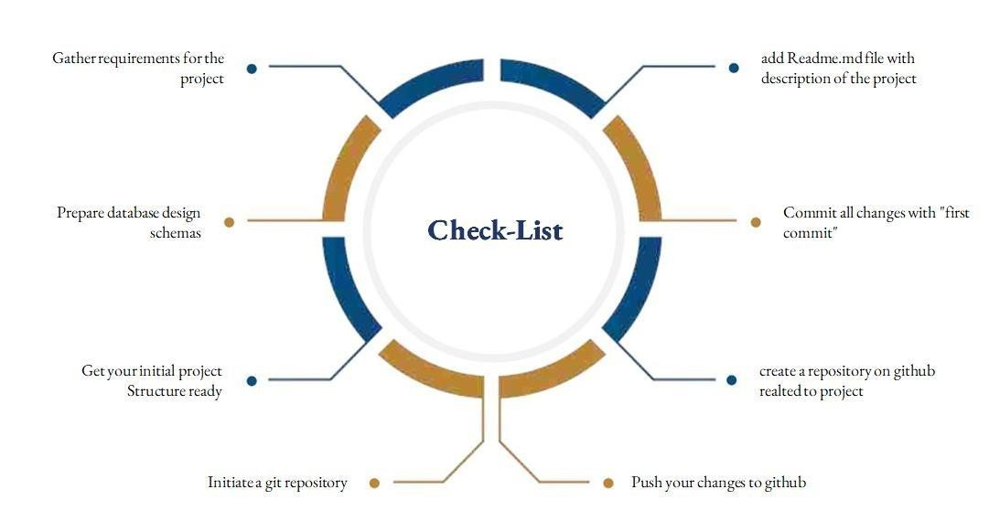
SUNSTONE
Assesment Parameter

Slide 5
Submission Github
SUNSTONE
https://github.com/jayashri-18/NM--AIT--GROUP4.git

Slide 6



SUNSTONE

